Slide 1


AI Masterclass
Technical Generative AI Concepts Explained Simply
github.com/Esteban-D-Lopez/TheAIWalkthrough

Slide 2
Learning Journey Roadmap
01
02
03
04
AI Masterclass
Technical Generative AI Foundations
Introduce foundational technical knowledge about AI and large language models (LLMs), laying the groundwork for understanding Generative AI.
Goals
Model Optimization Techniques 1
An overview of key LLM optimization techniques, with a deep dive into Fine-Tuning and Prompt Engineering.
Understand how GenAI technology works
Model Optimization Techniques 2
An overview of key LLM optimization techniques, with a deep dive into Retrieval Augmented Generation (RAG) and Agentic AI.
Feel comfortable exploring with GenAI tools
Start applying GenAI technology safely and responsibly
Generative AI Monitoring and Evaluation
An overview of key implications and practical considerations of bringing Generative AI products to life safely and efficiently.

Slide 3

Chapter 1: Technical Generative AI Foundations
The AI Walkthrough

Slide 4
What is Generative AI?
Learning Objective
Generative AI Defined
A field of artificial intelligence that uses machine learning techniques, particularly neural networks, to create new content by identifying and replicating patterns in data. Popular modern systems are often built using Large Language Models (LLMs) that apply natural language processing (NLP) to understand prompts and generate human-like text, code, or other media*.
Simply put, Generative AI learns from large sets of data to not just analyze, classify, or predict, but also to generate human-like text, code, and other creative content.
*Image generation tools use diffusion models, which learn patterns from millions of images and then generates new ones based on a text prompt.

Slide 5
Demystifying Generative AI Concepts
Technical Foundations
AI
Broad field of intelligent systems
Machine Learning
Algorithms learning from data
Neural Networks
Complex data processing systems
Generative AI
Branch creating new content

Slide 6
How do AI Chatbots work?
Technical Foundations
Generative Pre-Trained Transformer
Type of AI model designed to generate human-like text by predicting the next token.
Large Language Model
A massive neural network trained on large amounts of text to understand and produce language using NLP.
GenAI Chatbot
Neural Network
The underlying architecture of connected nodes (artificial neurons) that learn patterns from data by adjusting their connection strengths.

Slide 7
Neural Networks
Technical Foundations
Neural networks are a type of machine learning model that mimic the operations of a human brain to recognize patterns by adjusting the strengths of their connections based on data.
Hidden Layers (Deep Learning)
Input Layer
Output Layer
Product Mgmt
is
the ultimate profession.
They consist of layers of nodes, or artificial neurons, and layers. Each node connects to others and has its own associated weight and threshold.
Have been around since the 1950s.

Slide 8
Illustrating Neural Network Layers
Technical Foundations
Input Layer
Takes in raw data to initiate the process. This layer is crucial for feeding the network.
Hidden Layers
Processes input data using interconnected neurons. Learns patterns and derives insights.
Output Layer
Delivers the final result or prediction. Combines outcomes for an actionable output.

Slide 9
Large Language Models (LLMs)
Technical Foundations
Are massive neural networks trained on vast amounts of text to understand and generate human-like language by predicting the next token in a sequence.
Input
Output
“What is an LLM?”
“An LLM, or Master of Laws, is an advanced postgraduate academic degree…”
Although LLMs seem intelligent, they don’t truly understand their outputs. They simply predict likely next tokens based on patterns in their training data.
More on LLMs? Check out: https://www.datacamp.com/blog/what-is-an-llm-a-guide-on-large-language-models

Slide 10
Visualizing a Large Language Model
Outcome represents structured output.
01
Reflects user’s conversational intent.
02
Generates context-driven response.
03
Constructed from probabilistic analysis.
Large Language Models
Tokenization
Understanding Inputs
External textual datasets.
Input Data: Represents the queries, consisting of text prompts provided by the user.
Pattern Detection
Context Building
Processing Complexity
Processing: Actions taken by the model to understand and structure input into response.
Statistical language patterns.
Language Modeling
Outcome Generation
Probabilistic Sampling
Output: Results generated to answer user queries, crafted intelligently via processing logic.
Contextual token representations.
Response Structure

Slide 11
Natural Language Processing (NLP)
Technical Foundations
Branch of artificial intelligence that focuses on enabling computers to understand, interpret, and generate human language by combining linguistics, computer science, and machine learning techniques to process text and speech in a way that is meaningful and useful.
Fire
dead
jk
No cap
lit
hola
No way
ghost
salty
lol
LLM
NLP Model
(e.g., LLM)

Slide 12
Limited Context
Technical Foundations
LLMs can only consider a fixed window of tokens at once, and when they lose relevant information outside that window, they may fill the gaps by guessing, often leading to hallucinations.
Input
Output
Context window
(e.g., 128k tokens)
Max output
(e.g., 4k tokens)

Slide 13
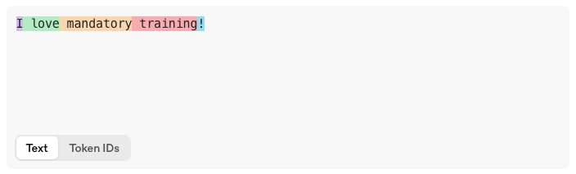
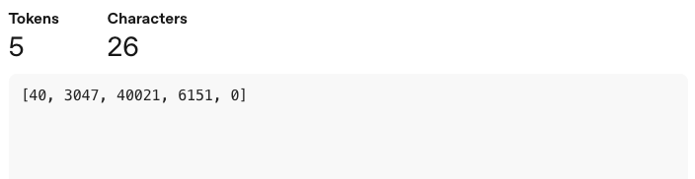
Tokenization
Technical Foundations
Tokens are the small chunks of text (parts of words, words, or punctuation) that large language models read and generate, and all their input and output is processed as sequences of these tokens.
Human-readable Words:
I love mandatory training
Token Count:
Token IDs:
4
One token generally corresponds to ~4 characters of text for English text (i.e., ¾ of a word).
https://platform.openai.com/tokenizer

Slide 14
Transformer Architecture
Technical Foundations
The Transformer model architecture revolutionized Generative AI by introducing parallel processing and self-attention mechanisms, significantly boosting efficiency and contextual understanding.
Self-Attention
Doesn't treat all words equally, focuses on the meaning of each word and weights its importance relative to others to enhance context understanding.
.
Parallel Processing
Reads multiple words simultaneously instead of sequentially to reduce training times and improving the model's ability to learn from vast datasets.
Scalability
Highly scalable, fueling introduction of LLMs.

Slide 15
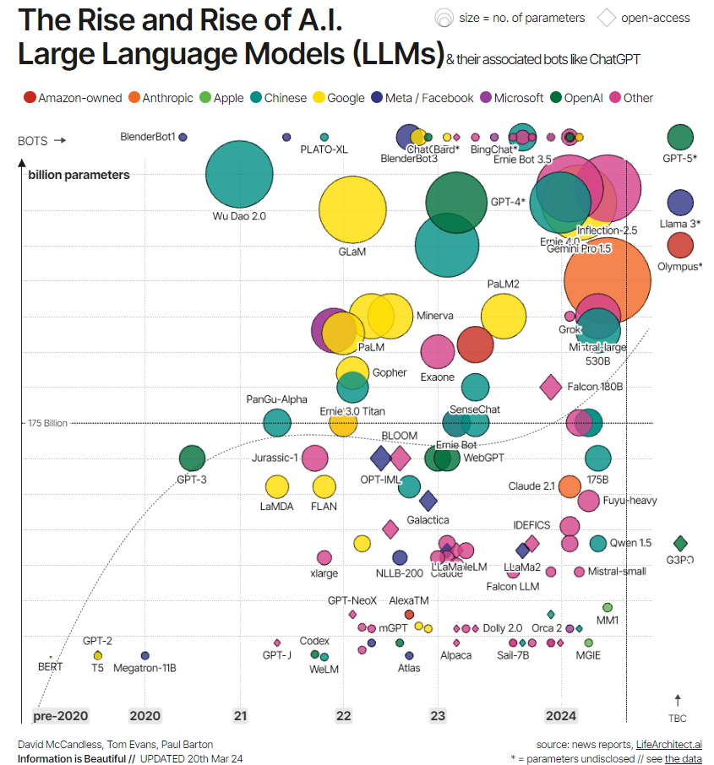
HOW LARGE
are Large Language Models?

Slide 16
HOW LARGE
are Large Language Models?
Understanding GPT-4's Scale
Model Size
Picture a soccer field covered with 30,000
Excel cells representing
the model's parameters.
3
Compute Size
2
Imagine a laptop running for 7 million years to complete the training.
Training Size
1
Visualize a 650 km bookshelf line filled with training data.
Source: Medium

Slide 17
AI Energy Consumption
1%
62k
10x
5y
3-4% of global electricity by 2030
Data Centers: Consume 1% of global electricity.
Training: GPT-4 consumed 62,000 MWh.
Data Centers
GPT-4 Training
Powers 1,000 homes for 5-6 years
Inference: Uses 10 times search energy.
Power: Equal to homes' usage for 5 years.
Uses 10x energy of Google search
Inference
Sources: Estimated energy metrics from OpenAI, DeepMind, and 2022 IEEE standards.

Slide 18

Model Optimization
Technical Foundations
Because large language models are so large, complex, and resource-intensive, it’s crucial to apply optimization techniques to guide them effectively, yielding more accurate, safer results while using resources far more efficiently.

Slide 19
Strengths and Challenges of Generative AI
Technical Foundations
Efficiency
Improved productivity: Generative AI automates complex tasks, saving time and resources.
Versatility
Adaptation: Can be tailored across domains for tasks like content creation or predictive analytics.
Opportunities
Revolutionization: Improves resource allocation, expands creativity, and aids decision-making.
Ethical Concerns
Privacy risks: Data handling raises questions about security and user privacy.
Bias in Outputs
Fairness issues: Outputs can reflect and propagate biases in training data.
Environmental Impact
Energy consumption: Training and operation may have significant environmental costs.

